Slide 1
Variant Calling
O. Harismendy, PhD
CMM262 – W2020

Slide 2
Clinical Applications
Genetic susceptibility
BROCA panel, Lynch, Li-Fraumeni
Early detection
Circulating tumor DNA
Patient Staging
IGVH / NOTCH1 in CLL
Unknown primary
Cancer specific mutational profiles
Sensitivity to targeted therapy
BRAF V600E / vemurafenib
Sensitivity to immunotherapy
Tumor mutational burden
Resistance to targeted therapy
EGFR T790M to 1st line NSCLC therapy
Anesthesia
Pharmacogenetic / drug metabolism
Prevention
Screening
Diagnosis
Treatment

Slide 3
Lexicon
SNV ≠ SNP
SNV single nucleotide variant
SNP single nucleotide polymorphism
Indel insertion-deletion
Variant ≠ mutation
Germline variant present in all cells of an organism
De novo variant germline not transmitted by parents
Somatic mutation variant not present in constitutive DNA
SV structural variants
Translocations, Duplications
CNA: copy number alteration
Loss vs. CN Deletion
Gain vs. CN Amplification
Functional effects
Stop-gain=nonsense
VUS: variant of unknown significance
MAF ≠ MAF
(M)AF minor allele frequency (population)
(M)AF mutant allelic fraction (cancer)
Coverage Breadth ≠ Depth
depth number of reads aligned per nucleotide
breadth fraction of an interval/target covered

Slide 4
A three variables trade-off
Depth ~ sensitivity
5 Gbp = 50 Mb at 100x in 1 sample
500kb at 100x in 100 samples
100kb at 5000x in 10 samples
instrument throughput
Multiplex
~cost
Breadth
~utility
Optimize information (utility) x cost

Slide 5
A three variables trade-off
Depth ~ sensitivity
instrument throughput
Multiplex
~cost
Breadth
~utility
Optimize information (utility) x cost
Zhou (2018)

Slide 6
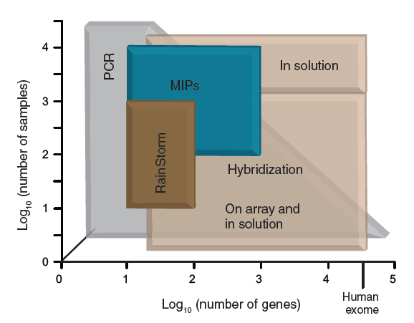
Targeting methods
Polymerase Chain Reaction (PCR)
Multiplex PCR (AmpliSeq)
Multiplex PCR+
MIP/Padlock probes
GoldenGate (Illumina)
Microfluidic PCR
Droplet PCR
Fluidigm
Capture (or Enrichment)
Hybrid selection
DNA selection
Array selection
Mamanova (2010)

Slide 7
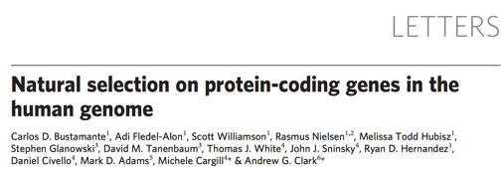
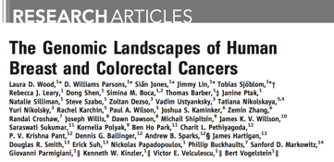
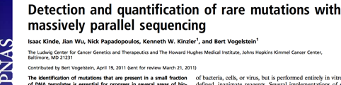
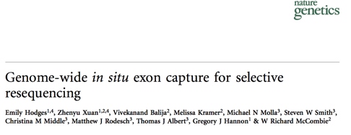
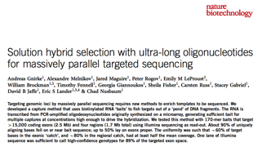
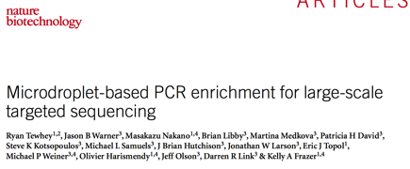
Targeting timeline

Slide 8
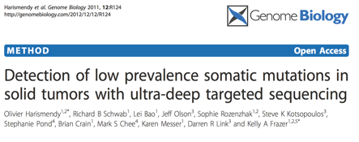
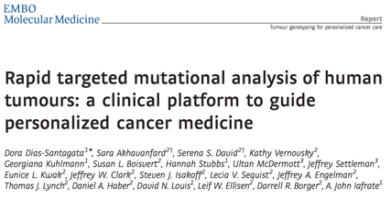
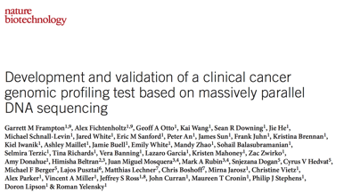
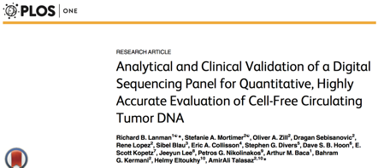
Targeting timeline
RainDrop (UDT-Seq)
Foundation One
Guardant 360
SNaPshot
Notes:
Clincial applications were 2 5 years behind.

Slide 9
Hybrid Selection
Baits: short biotinylated RNA (~120 mers)
Pond: pre-amplified fragmented DNA
Catch: enriched for ”baited” fragments
Specific Enrichment
80-90% of the reads land within 200bp of the targets
Gnirke (2009)

Slide 10
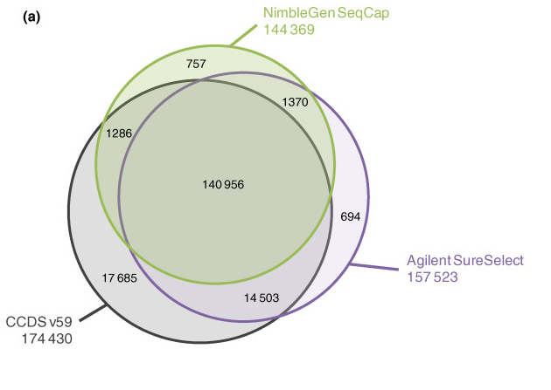
Variable “Mileage”
Whole exomes
Clinical panels
Assay Name | Assay type | N genes
 |  | Hotspots | selected exons | All exons | CNA | Fusion
SNaPshot | base extension | 15
Affymetrix oncoScan | microarray | 9 |  |  | 900
Foundation One | targeted sequencing |  |  | 315 | 315 | 28
Guardant 360 |  |  | 73 |  | 18 (amp) | 6
PGDx CancerSelect125 |  |  |  | 117 | 41 (amp) | 29
TEMPUS xT |  |  |  | 593 | 593? | subset
Watch out for “blind spots”
Sulonen et al (2011)

Slide 11
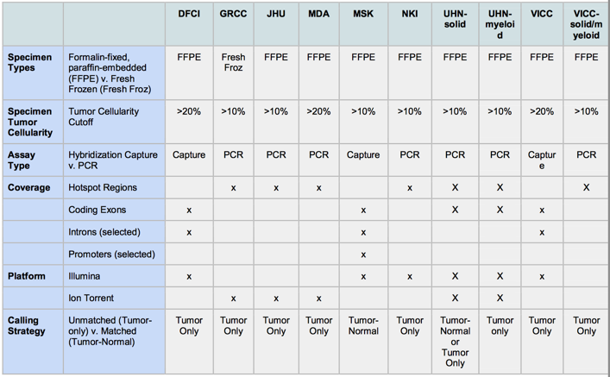
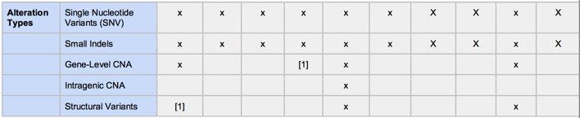

Variable “Mileage”
Whole exomes
Clinical panels
Watch out for “blind spots”
Sulonen et al (2011)

Slide 12
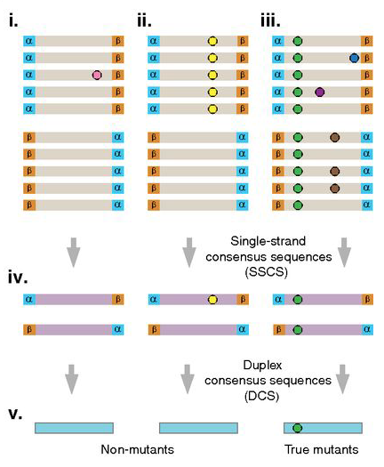
Enhanced accuracy (barcodes)
A unique molecular barcode (8-12 nt) is added to each DNA fragment
PCR duplicates will share barcodes
elimination of PCR errors
Duplex barcoding by strand
elimination of of early damage, errors
Schmitt (2012)

Slide 13
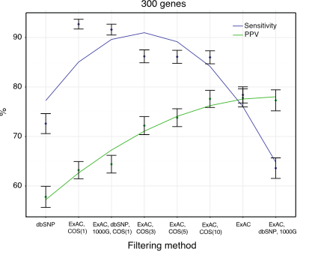
Enhanced accuracy (matched normal)
Pros
Eliminate sequencing artifacts
Eliminate coverage artifacts
Eliminate germline variants
Cons
Logistically challenging
Increase cost
Mitigation
Using a set of “generic” normal
Filter out known inherited variants (1000G, GNOMAD)
Curate actionable variants (COSMIC, ONCOKB,…)
93% of FP are VUS
Garofalo (2016)
Notes:
https://www.ncbi.nlm.nih.gov/pubmed/25877891
https://genomemedicine.biomedcentral.com/track/pdf/10.1186/s13073-016-0333-9
https://www.sciencedirect.com/science/article/pii/S1525157817305986#bib11

Slide 14
Structural Variants (CNA)
Ratio of coverage depth (tumor / normal)
also works with “generic normal”
AND
Allelic fraction at heterozygous SNPs
loss of heterozygosity
Poor detection of translocations
breakpoints are not in exons
Accuracy increases with purity
Normal vs tumor
Kobolt (2012)

Slide 15
Structural Variants (gene fusion)
Breakpoints are often in introns
Breakpoints vary between patients
Tiled probes/baits in introns increases sensitivity
BUT
Requires broader assay, increased cost
RNA-Seq would be more sensitive
Yang (2018)

Slide 16
Mutation identification
Compare N reads supporting alternate and reference alleles
Probabilistic calling (Tumor only or tumor normal pairs)
Mutect, Varscan, Vardict, Strelka
Heuristic filtering
Depth
Quality
Position within the read
Allelic Fraction
Strand bias
...
Visual inspection

Slide 17
Multi-step analysis

Slide 18
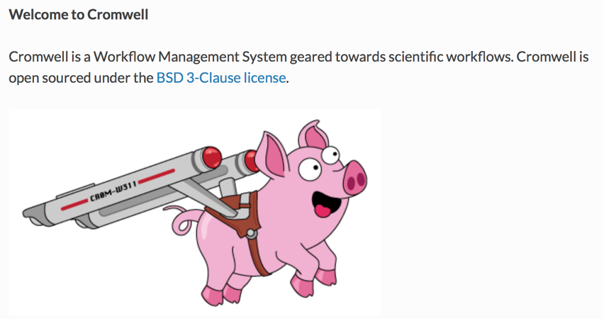
Multi-step analysis

Slide 19
File Sizes
 | Depth | FASTQ.gz | BAM | VCF.gz
Genome | 30x | 100-200Gb | 100-200Gb | 2Gb
Exome (50 Mb) | 120x | 5-10 Gb | 10-30Gb | 3-6Mb
Deep Targeted (150 kb) | 1500x | 300-500Mb | 150Mb | 3-6Mb
Assume 100 bp read length

Slide 20
APPLICATIONS TO CANCER RESEARCH

Slide 21
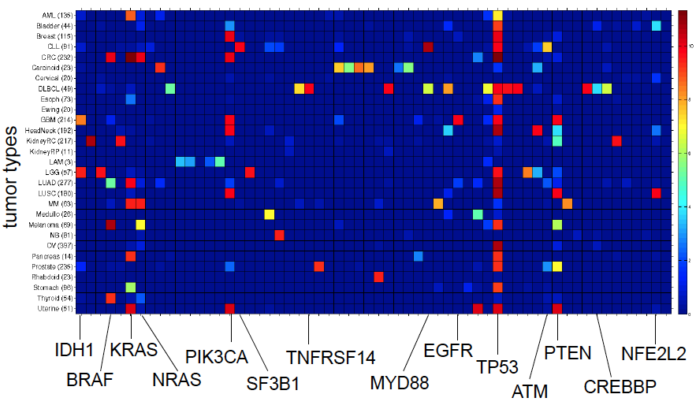
Finding Driver Genes
Adapted from Lawrence et al. Broad Institute

Slide 22
Finding Driver Genes
Every tumor has 100’s of mutations
Which ones are cancer driver vs passenger ?
Mutation rate varies:
Cancer type (Skin>Leukemia)
Sequence context (C>T due to UV)
Patients (TP53 _{mut} > TP53 _{WT})
Gene transcriptional level (low>high)
Replication timing (late>early)

Slide 23
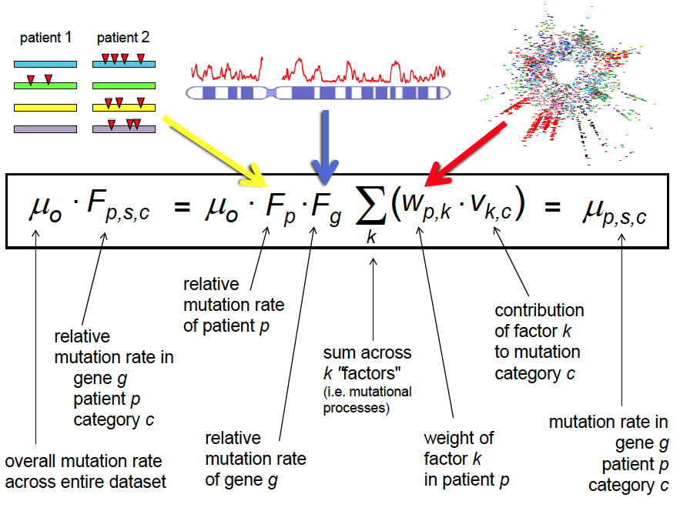
Finding Driver Genes
Adapted from Lawrence et al. Broad Institute

Slide 24
Mutational Signatures
Case1 profile
Case2 profile
Alexandrov (2013)

Slide 25
Mutational Signatures
Alexandrov (2013)

Slide 26
Mutational Signatures

Slide 27
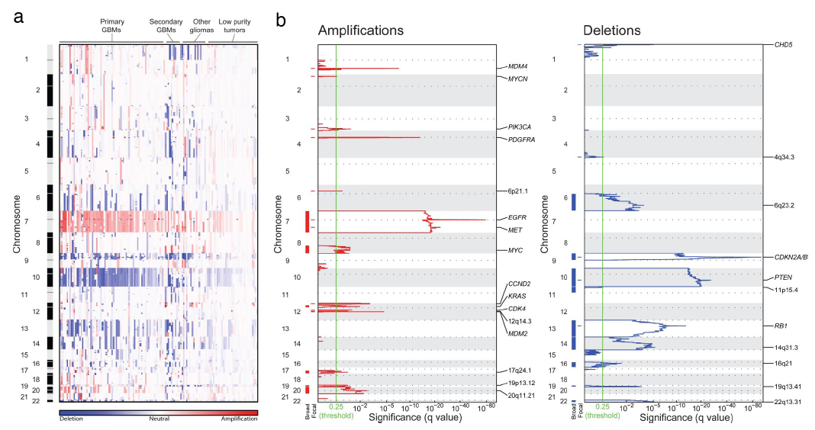
Copy Number Aberrations

Slide 28
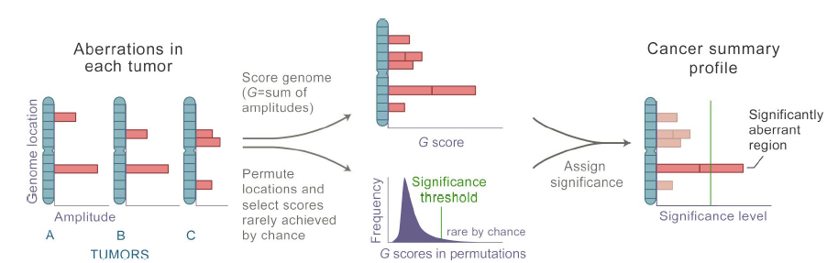
Copy Number Aberrations
Beroukhim et al (2007)

Slide 29
Copy Number Aberrations

Slide 30
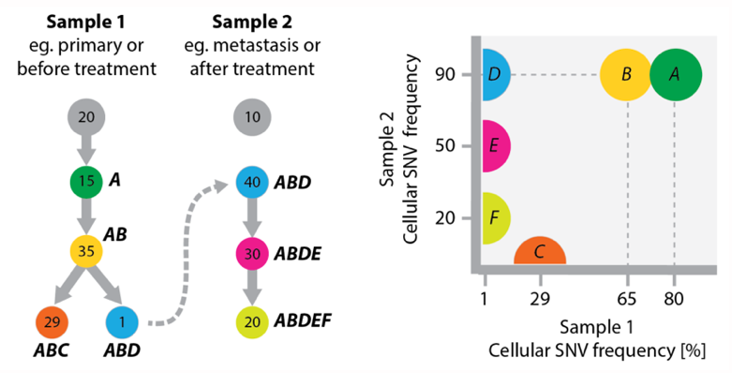
Looking forward
Standardized TMB
More sensitive MSI
T-cell receptor diversity
HLA-matched mutanome
Mutational signatures
Structural signatures
Clone prevalence
Inferred from data
With Single-cell profiling
Markowetz (2014)
Notes:
https://www.sciencedirect.com/science/article/pii/S2211124714003738

Slide 31
APPLICATIONS TO CANCER CARE

Slide 32
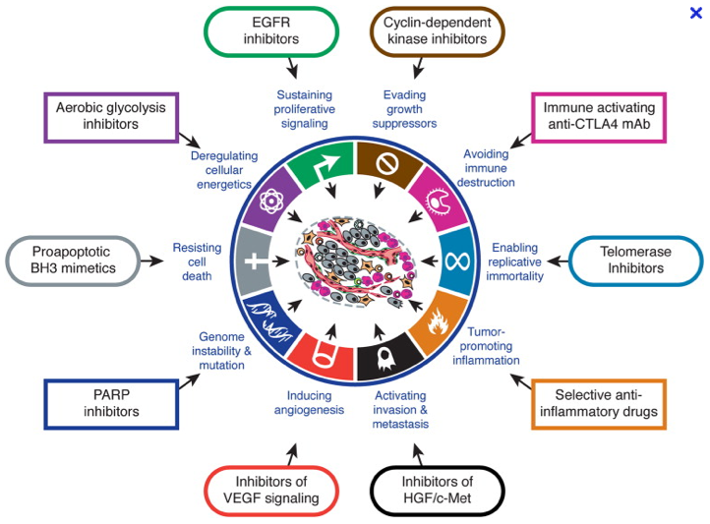
Personalized Cancer Treatment
Weinberg 2011

Slide 33
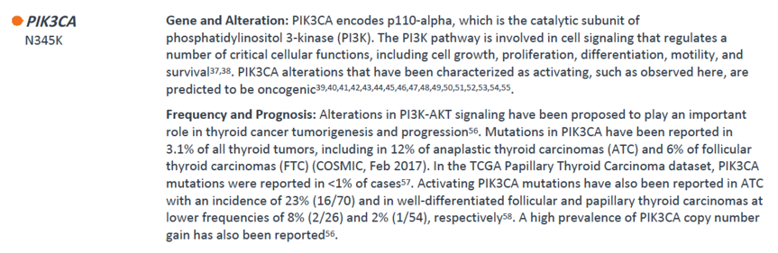
Personalized Cancer Treatment
Weinberg 2011

Slide 34
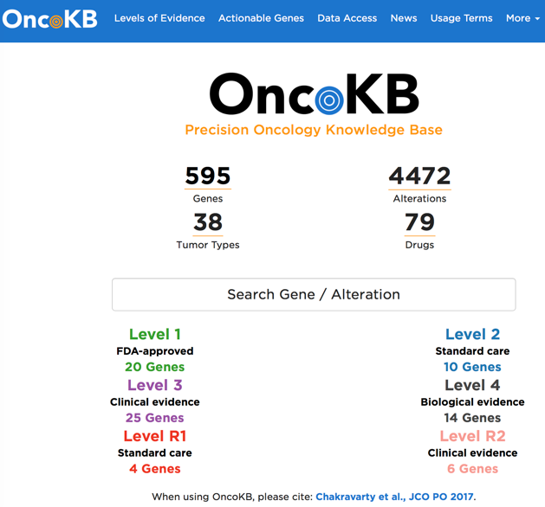
Personalized Cancer Treatment

Slide 35
Personalized medicine ecosystem
CLIA/CAP technical validity
Training of Professionals
Variant Interpretation
Incidental findings
Insurance Coverage
Drug Availability
Clinical Utility
Notes:
I only described the technical aspect of identifying mutation and variants in the cline.
But many other aspects need to be address before the promise of personalized medicine can be fully realized.
You are here to learn more about it

Slide 36
HRD Test for PARPi

Slide 37
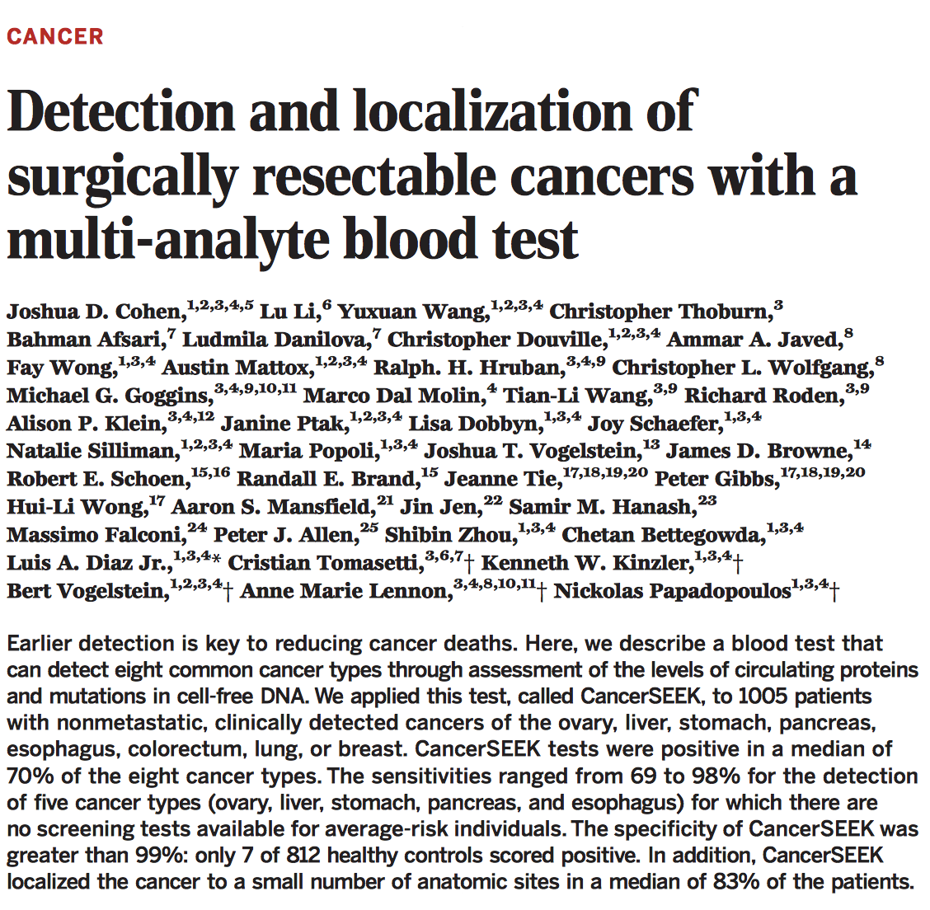
Early Detection

Slide 38
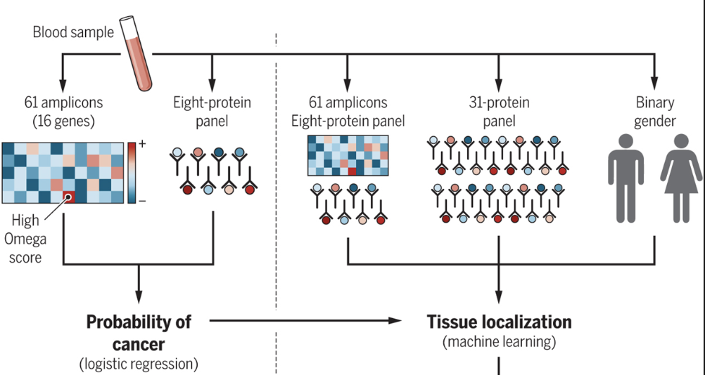
Early Detection

Slide 39
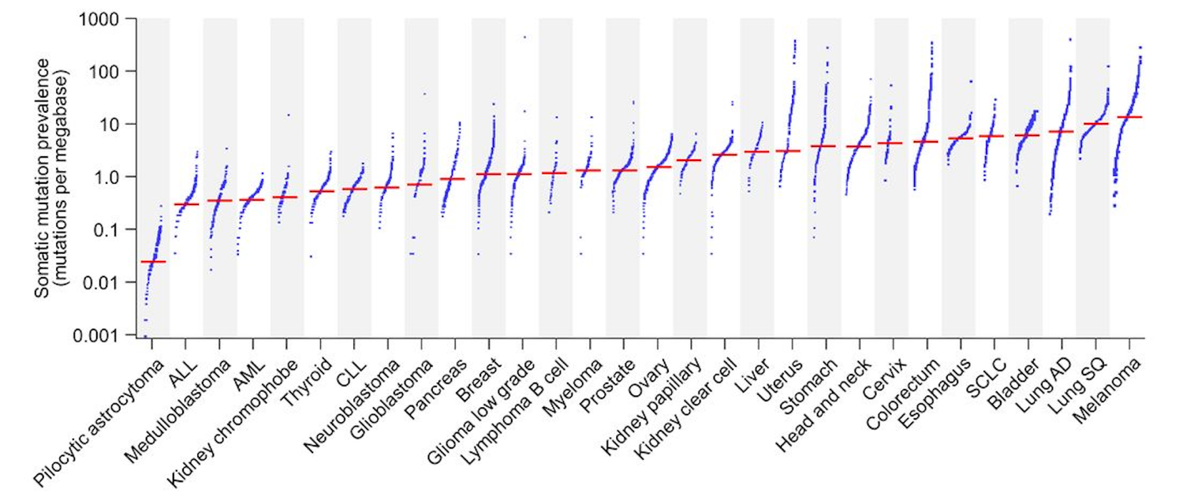
Tumor Mutational Burden

Slide 40
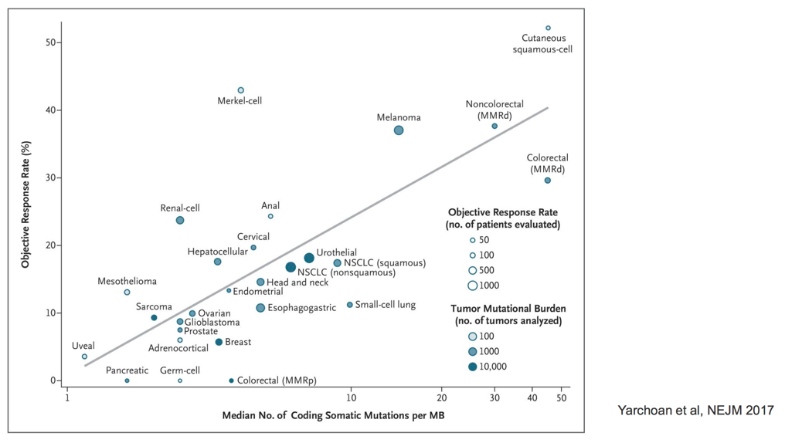
Tumor Mutational Burden for IO

Slide 41
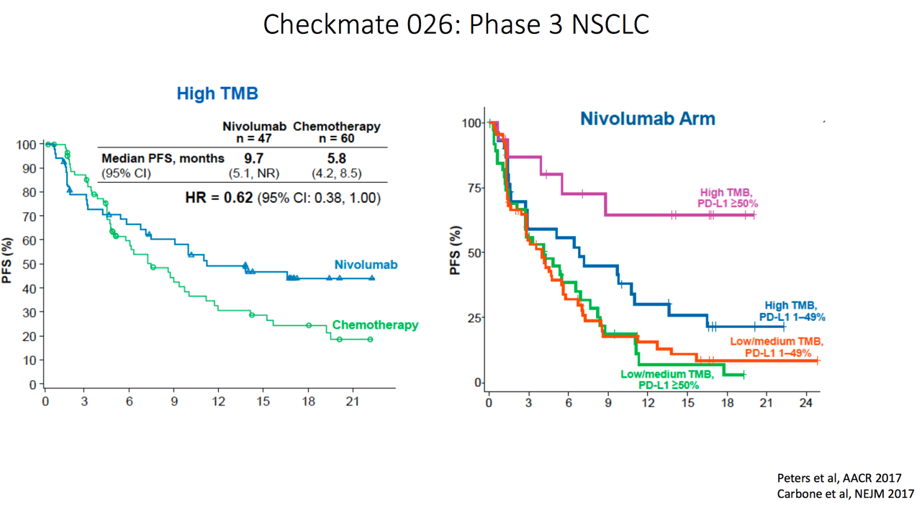
Tumor Mutational Burden for IO

Slide 42

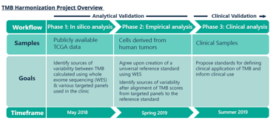

Looking forward
Standardized TMB
Source of variation
Biological (tumor heterogeneity, purity, subtype)
Analytical (sample quality)
Technical (assay type, gene panel, coverage depth)
Computational (filtering rules)
Stenzinger (2018)

Slide 43
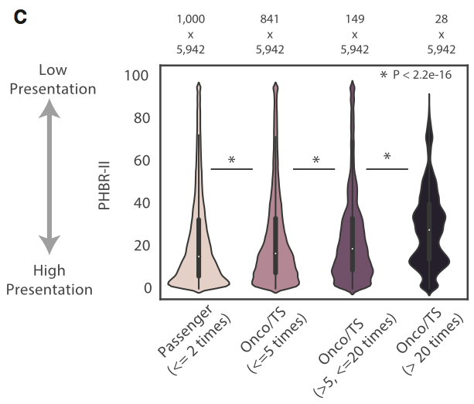
Looking forward
Standardized TMB
HLA-matched mutanome
cancer drivers are poorly presented
Marty–Pike (2018)

Slide 44

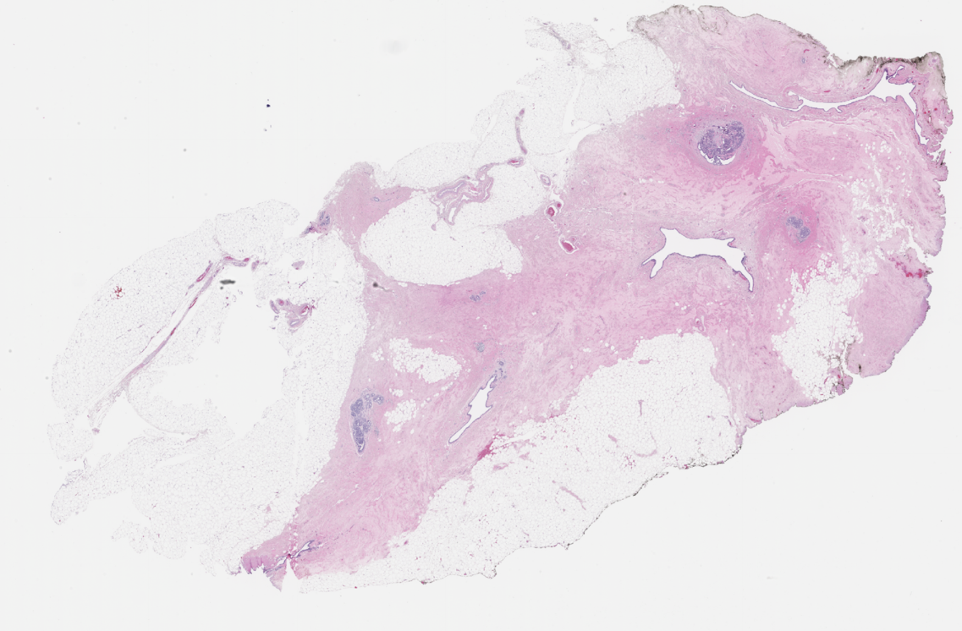
Pre-cancer Atlas / Genomics WG
1 mm

Slide 45
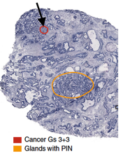
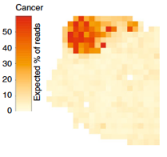
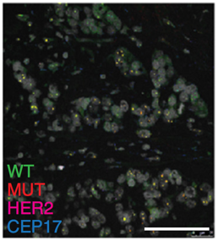
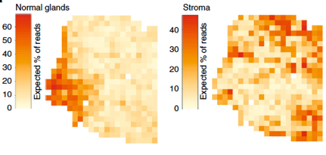
Looking forward
RNA
DNA
Standardized TMB
HLA-matched mutanome
In situ genomics
Berglund (2018)
Janiszewska (2015)
Notes:
https://www.ncbi.nlm.nih.gov/pubmed/26301495
https://www.nature.com/articles/s41467-018-04724-5

